Slide 1
Proprietary & Confidential
ADK Train-the-Trainer
March 2025

Slide 2
Outline
Introduction (20 Min )
Welcome - Meet the team
Agent Landscape GCP
Allowlisting - Overview
Hands on Training (75 Min)
Foundational Concepts (15 Min)
Building a basic agent using Agent Kit (30 Min)
Advanced Concepts (30 Min)
ADK deployment to AE
Agent Evaluation on ADK
Integration with Agent Space (15 Min)
Q&A and Wrap-up (10 Min)

Slide 3
Introduction

Slide 4
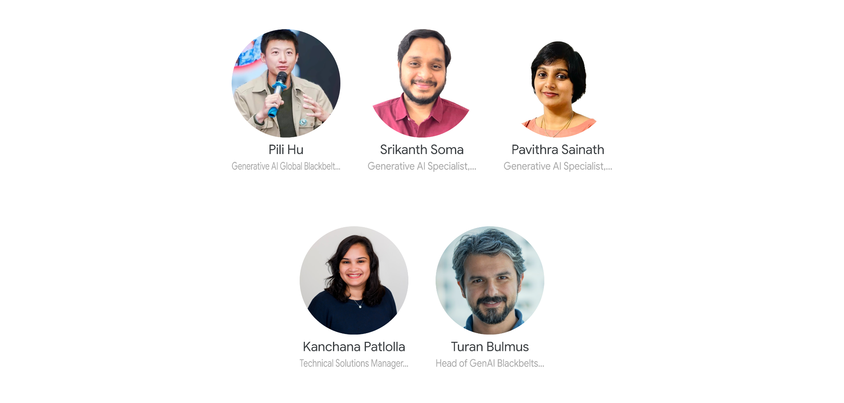
Meet the team
go/aaie-agents

Slide 5

AI Agents plan, reason, and execute tasks for users
End user
Four key components
Model(s): Used to reason over goals, determine the plan and generate a response
Tools: Fetch data, perform actions or transactions by calling other APIs or services
Orchestration: Maintain memory and state (including the approach used to plan), tools, data provided/fetched, etc.
Runtime: Execute the system when invoked
Query
Response
Agent runtime
Orchestration (e.g. Agent Brain)
Tools
Tools
Generative AI models
(An Agent can use multiple models)
Profile, goals & instructions
Memory
Tools
Short-term
Long-term
Model-based reasoning/planning
(Question decomp & reflection)
APIs
Functions
Databases
Agents
Notes:
So, what even is an "agent"? It's one of those terms that means something different depending on who you ask, but don't waste time trying to nail down the definition perfectly, this graphic is an adequate mental model.
For gen AI agents, what we are doing is giving a LLM access to tools, APIs, and data. Plus, instructions and examples. We then ask the LLM many times in a loop. This is awesome, because it lets the model do so much more than it could on its own. The LLM itself is, just one of many components for the construction of an AI agent.
Four key components:
Model: Used to reason over goals, determine the plan, and generate a response
Tools: Fetch data, perform actions or transactions by calling other APIs or services
Orchestration: Maintain memory and state (including the approach used to tools, data providers, etc.)
Runtime: Executes when invoked

Slide 6
Agentspace no-code Agent builder UI
Agent Marketplace and Agent Garden (templates)
Polysynth (part of CES)
(Business users)
Agent tools and context
Discover, build and deploy agents
Models
Enterprise Automation
Complex Enterprise Apps, Agent Plan ←→ Workflow
Google Agent Development Kit
Client side SDK to define multi-agent applications for complex, real world scenarios
Gemini API
Tool use
Orchestration
Enterprise administration and governance
Gemini Models
Optimized for Agentic reasoning, planning and grounding
Enterprise Context
Tool Knowledge Graph & Planner for 100s of APIs, your APIs & Workflows Constrained by your Policies and Rules
Vertex AI Agent Engine
Fully-managed runtime to deploy and manage agents in production
Monitor, log, and trace
Example store
Managed session and memory
Evaluation
Code execution sandbox
Framework and model agnostic
Data & RAG
Google Search on web or your data + data agents via BigQuery/AlloyDB
Agent Garden
Samples and tools to accelerate agent development
Model Garden
Hundreds of curated LLMs
‹#›
Notes:
Here’s a stack-view of the Agent Platform we are working on.
The green boxes in the middle are the framework and the runtime, what customers are going to be building agents with… but the platform is really all of these parts working together. Agent Engine has one SKU today, as a runtime but it will end up as a suite of atomic services for agents
Gemini will get better at agentic tasks because of use cases and data it gets from the platform. This is actually huge, that the gemini quality team is taking on these use cases for hill climbing is a very clear and legitimate differentiator.
On the left hand side, many BAP tools, automation, AppSheet and other services are coordinating on providing APIs and workflows as tools for agents, or in some cases a thin agent on top of an existing business application. This is another differentiator - not just a collection of APIs as tools, but layers of agent-specific infrastructure co-built with the Agent Platform, so tools work better within agents.
These will collectively result in many differentiated capabilities.

Slide 7
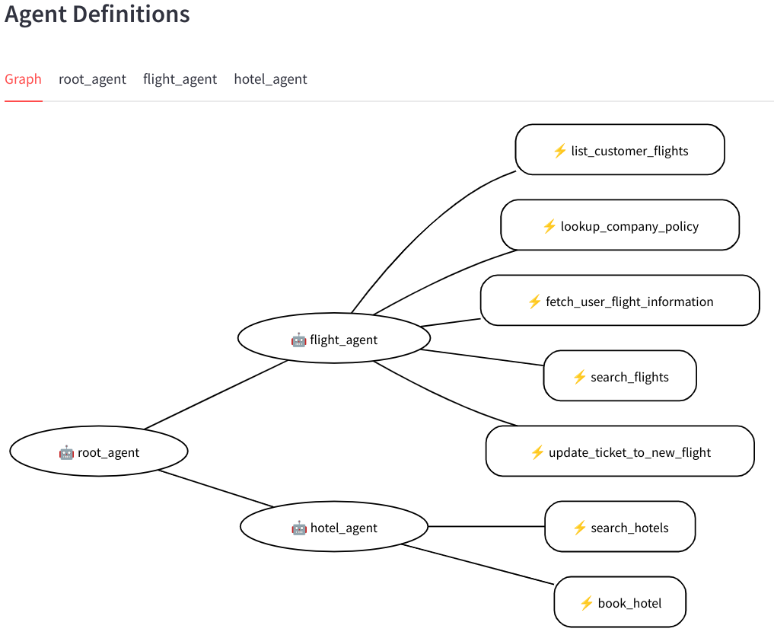
Agent Development Kit
Client side code framework and SDK to build sophisticated, multi-agent solutions
Define multi-agent applications orchestrating actions across many agents and tools
Interleave deterministic logic with actions driven by gen AI reasoning for effortless, hybrid agents
Intuitive local dev UI for fast iteration; visualize agent topology and trace agent’s actions
Gemini is the default, but any generative AI model is supported, including fine-tuned models
Live audio, video, screen bi-directional streaming
Build your agents, how we build agents.
Notes:
We are exposing a SDK to customers - how we build our production agents, now you can use the same sets of tools.
It's a sweet spot between easy to use and high levels of control and quality.

Slide 8
Comparison
Langgraph
CrewAI
Autogen/ag2
Agent Framework
stateful, multi-actor applications using LLMs, focusing on cycles, controllability, and persistence for building robust agent workflows
More developer adoptions due to time in the market and existing Langchain customer base.
Production customers: LinkedIn, Uber, Replit, and Elastic
assemble teams of AI agents, each with their own role and expertise, to tackle complex tasks collaboratively
Popular for prototyping. Adoption rate in Enterprise is fairly small
Multi-agent conversational framework and enhanced LLM inference optimization
Research based. Integrations to Azure Prompt flow still needs work
Recent split with ag2 governance
Semantic Kernel becoming the standard
Framework that provides multi-agent building capabilities with flows, tools, memory that is composable and reusable
Backed up with the Deepmind, CAIR innovation
Google Cloud ecosystem and enterprise existing adoption through BAP
Framework Comparison Matrix
Notes:
SK supports prompt templating, function chaining, vectorized memory, and intelligent planning capabilities out of the box.

Slide 9
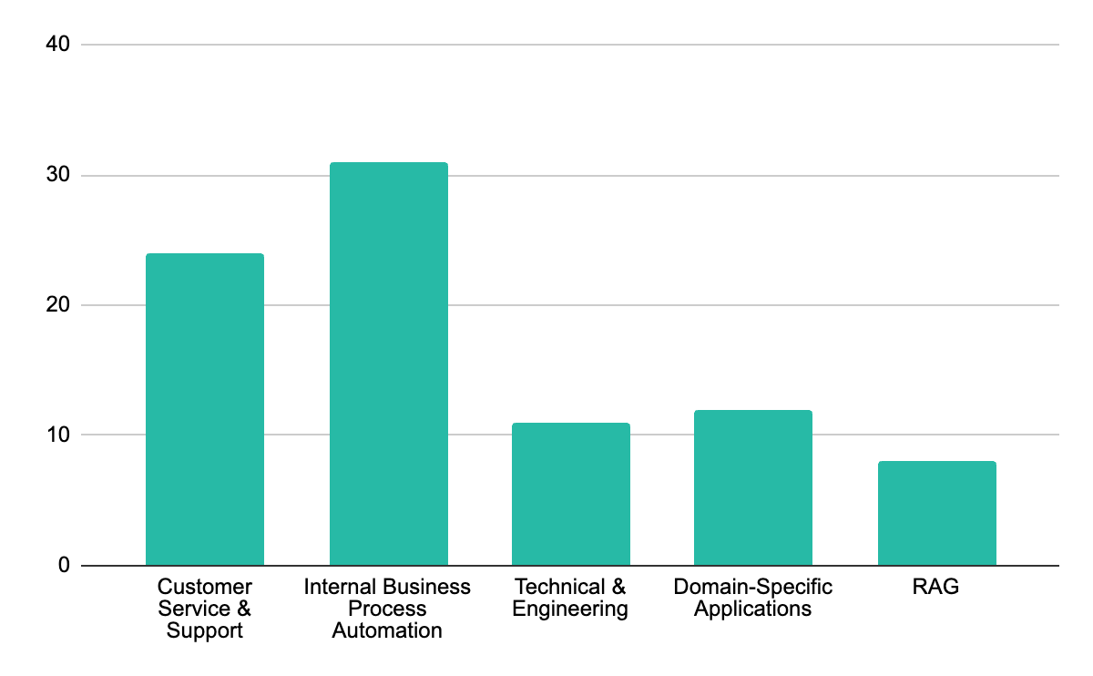
Allowlisting - Customer Summary
After 8 weeks, of 32 customers in our white glove pipeline, 19 are “active”: 9 have received a first touch, 7 are actively exploring the framework, and 3 have working agent demos committed to deploying with Google Cloud.
First touch (10)
Hands-on (7)
Committed (4)
The Facts
Prosus, LATAM, Mr Cooper, L’Oreal, Deutsche Bank, Home Depot, Target, Mayo, Charles Schwab, Spotify
Mercedes Benz, Micron, Vodafone, GitLab, Caixabank, GoReply, Datatonic
Ford, Renault, Revionics, PANW
233
33
Allowlisted
In the pipeline for white glove
Key Differentiators
21
8
Here’s what customers and internal partners are saying about Agent Framework.
Core Value Prop
Fastest time to value
Developer UI is “a hit”
Actively engaged
Prospects for Cloud Next
Customers comparing us to LangGraph say that it’s way faster to build with us
Customers love the developer UI, and they want to see more
Use cases
BiDi Streaming
Out of the box flows
Callbacks - simple control
It’s the only agent framework supporting bidi streaming, and customers are excited
Our multi-agent flows support all the customer use cases we’ve seen, and make it easy to go zero-one.
Callbacks provide a simple interface for controlling agent behavior, enhancing ease and trust

Slide 10
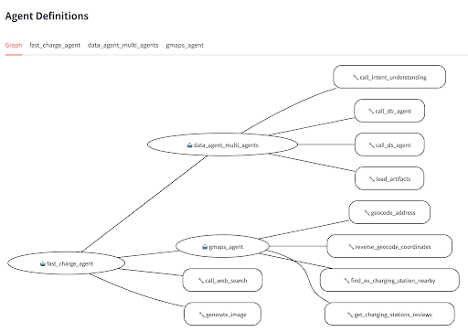
Deep Dive - Renault: Fast Charger Site Selection
Challenge: Selecting optimal locations for fast EV chargers across Europe is currently a slow, complex, and manual process. It requires analyzing diverse data sources like traffic patterns, competitor locations, and urban planning regulations.
Agent Solution: This agent is designed to automate and revolutionize this site selection process using AI. It aims to replace the manual analysis with an intelligent AI-powered solution, maximizing the ROI of charger installations by effectively leveraging Renault's internal BigQuery data and external APIs.
Renault has built the Agent solution over 3 iterations. The final agent v2:
Has 1 router agent, and 2 children, with 10 tools overall. Including:
Google Maps Tools (for location queries)
Web Search Tool (for external information retrieval)
NL2SQL agent
Notes:
Private preview tracker

Slide 11
What Renault Liked About Agent Framework
Flexibility and Ease of Use Drive Positive Experience
Helpful Examples: The data science agent example was crucial for development. ("Samples are very helpful...even if we are not familiar with the code").
Easy Refactoring: The ability to easily restructure the agent from a single agent with 10 tools to a multi-agent system was highly valued. ("It was easy to refactor").
Python Functions as Tools: This feature was unique and highly beneficial, saving significant time by allowing Renault to leverage existing Python code. ("We didn't see it in any other framework...it is a lot of time saved.")
Agent as Tool: The flexibility offered by encapsulating agents as tools was a major plus.
UI & Artifacts.
SQL verification: They liked being able to see the generated SQL.
Saving sessions: Storing of good and bad sessions was found useful.
Notes:
Private preview tracker

Slide 12
Renault: Challenges, Gaps, and Future
Addressing Limitations and Planning for Future Integration
What They Didn't Like:
Sub-Agent Routing: Sub-agents didn't reliably transfer control back to the router agent, requiring manual intervention.
Limited UI Customization: Image outputs in the UI were too small and not resizable.
Long and hard to read logs.
Dataset Metadata: Reliance on well-described BigQuery datasets highlighted the need for automated metadata generation.
Missing Multi-Modal Web Surfer: A crucial capability for scraping internal websites lacking APIs.
Evaluation did not work.
Major Gaps Identified:
Cost Estimation: Need for tools to estimate and track costs (token usage, BigQuery costs).
Human-in-the-Loop (HITL): Clearer guidance and samples needed for implementing HITL feedback on execution plans.
Lack of Custom Library Support: Inability to add custom libraries to the code interpreter.
Notes:
Private preview tracker

Slide 13
Hands on Training - Foundational Concepts

Slide 14
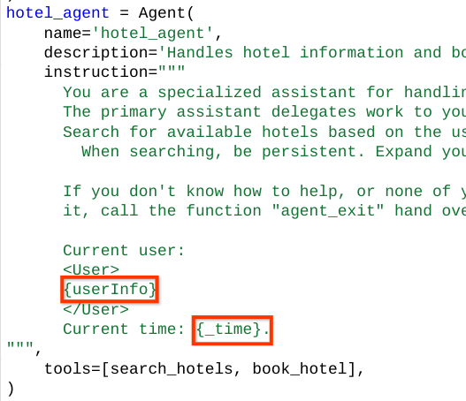
Instructions
Very simple interface for the developer to express what they want the agent to do. This authoring experience is much better than composing a chain, a graph, or a crew / agent / task relationship.
You can reference context from the instructions, which will be replaced by real data at runtime.

Slide 15
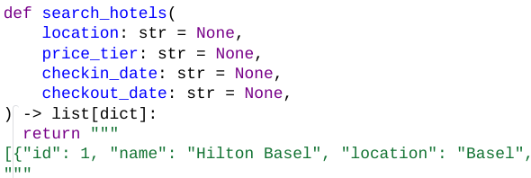
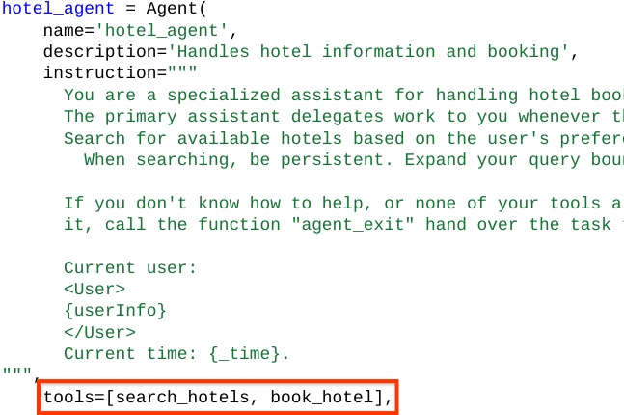
Function Tools
Developers can provide multiple types of tools to the agent. One of the most common case is Function Tool. By providing a python function to the agent, the agent calls that function automatically when needed.

Slide 16
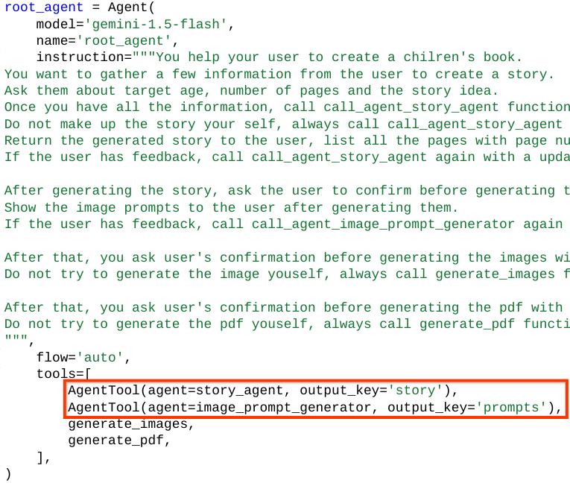
AgentTool
We can add an agent as a tool to another agent.
AgentTool is executed in an isolated environment so you can call agents built by other people safely.
Combined with input / output schema, AgentTool can be really powerful to implement complicated interactions.

Slide 17
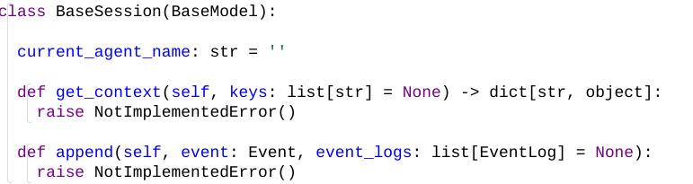
Sessions
We want to offload session management from developers’ shoulder.
We defined a BaseSession interface, and allow developers to either use a managed session storage that Google provides, or easily plug-in their own session storage.
We also provide a InMemorySession which will make developing and debugging really easy and fast.

Slide 18
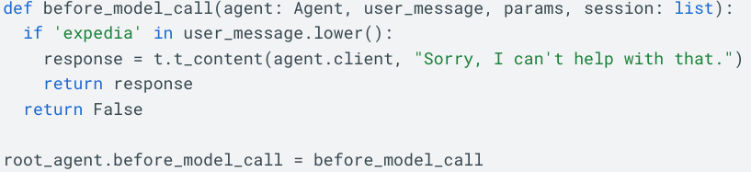
Callbacks
Agent provides callback for developers to customize agent’s behaviors.
In the callback, the developer has the opportunity to interrupt the agent’s response and handle the request with their own logic in code.
This is how one can mix AI’s intelligence with fixed logic in code.
Available Callbacks: before_model_call, after_agent_callback, before_agent_callback, before_tool_callback, after_tool_callback,

Slide 19
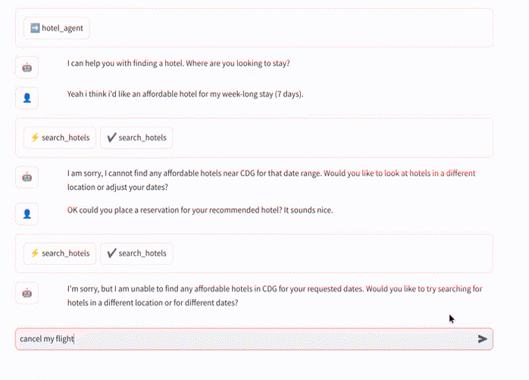
Event Streaming
When the agent is working on a complex task and has to make multiple rounds of tool calls, you don’t want the end user to wait for a long time.
Event streaming allows developers to get individual event one after the other from the Agent Framework, so that they can update their users during the agent execution.

Slide 20
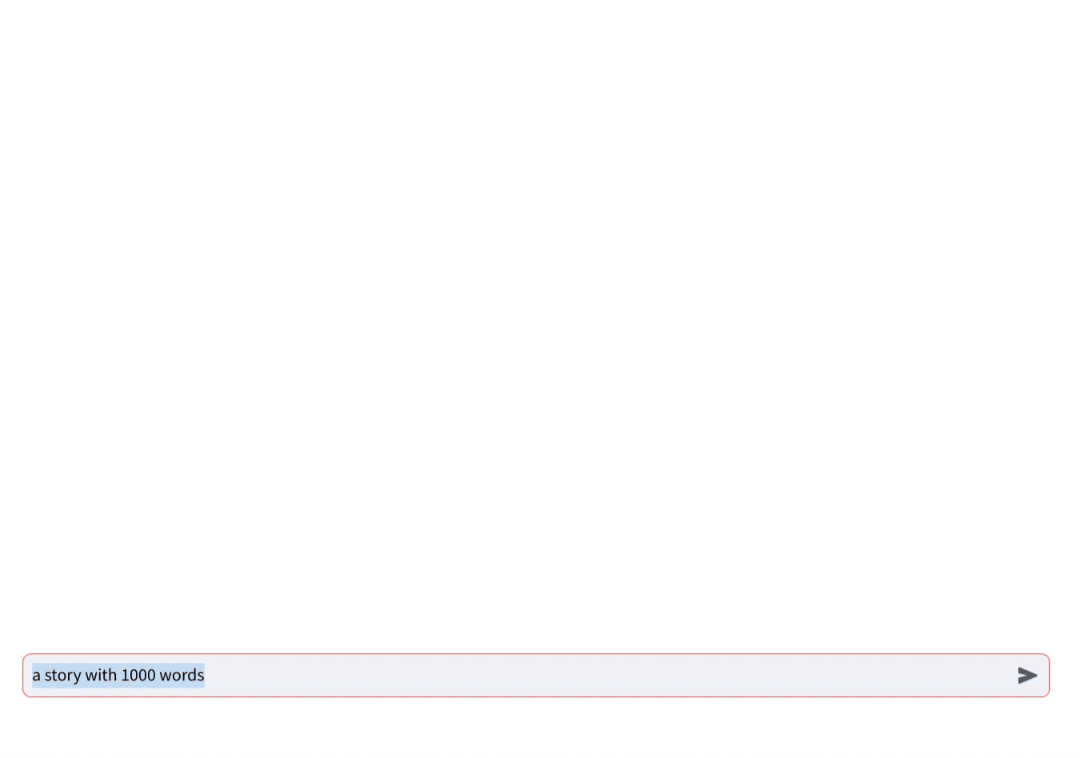
Text Streaming
Text streaming further reduce the perceived latency because the end user doesn’t have to wait for the entire response to see the first word.

Slide 21
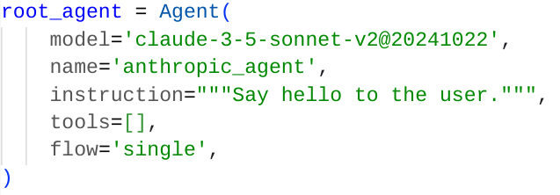
Anthropic Models
In the Agent Framework, everything is an interface that supports multiple implementation to give developers all the flexibility. This includes the LLM models. We’ve added the support of Anthropic models, which uses a different protocol than our Gemini models.
Each agent can use a different model best suited to their purpose.

Slide 22
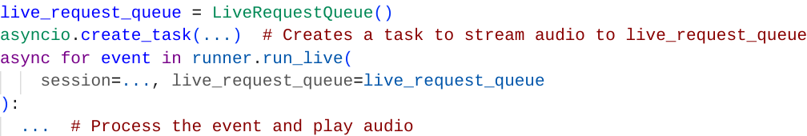
Bidi-streaming
Built on top of the Live API in the GenAI SDK, a very simple interface for sending audio streams to the agent, and process audio output from the agent. A lot of technical details and caveat for asyncio and streaming are handled by the framework, so the developers don’t have to worry about them.
You don’t have to change any of your agent code to make it a bidi agent. Simply use a different runner method: run_live() instead of run()

Slide 23
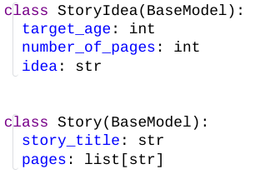
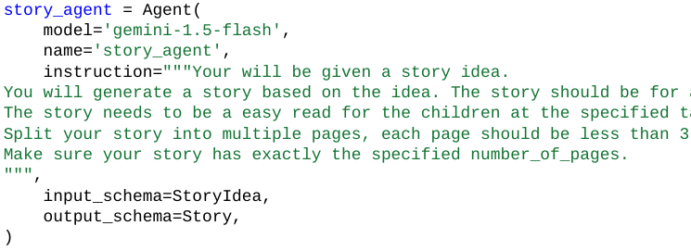
Input Schema / Output Schema
You can now define Pydantic classes and use those as input and output schema. The agent will verify the input against the schema and guarantee to generate JSON data according to the output schema using constrained decoding.

Slide 24
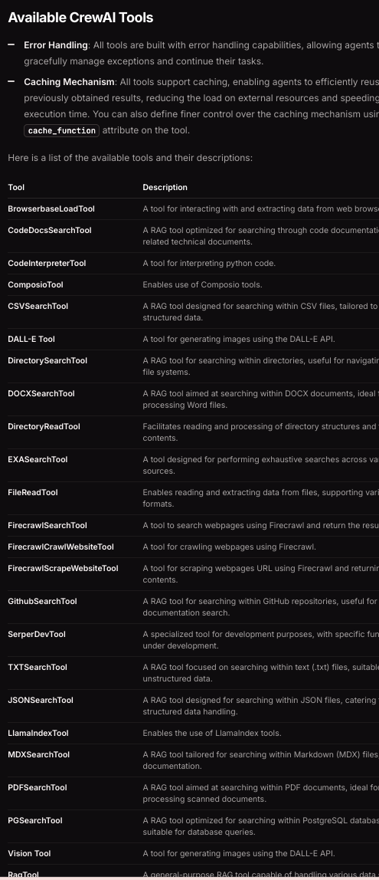
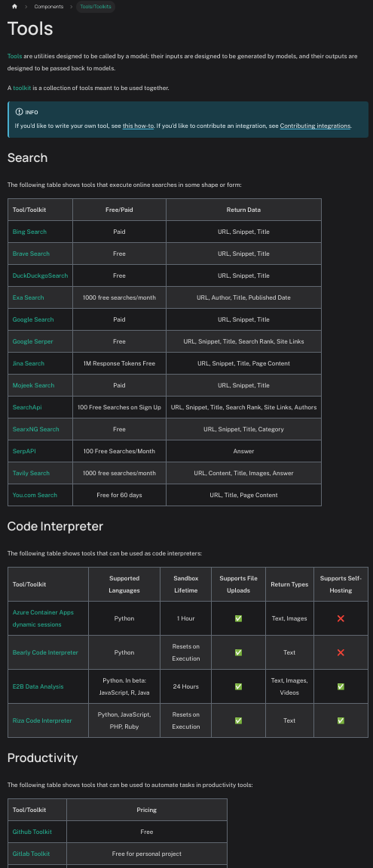
Interoperability: Tools
LangChain has 100+ tools.
CrewAI has 30+ tools.
ADK has a tool adapter so those tools can be used in our framework directly.

Slide 25
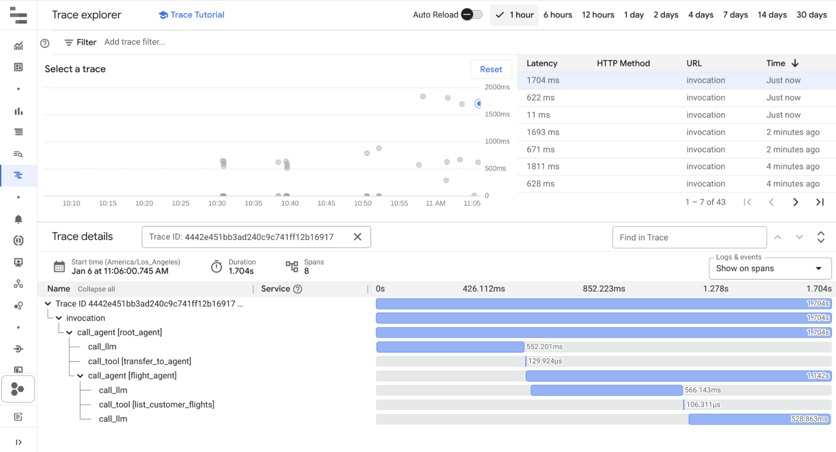
OpenTelemetry and CloudTrace
The ADK integrates with Google Cloud Trace for centralized tracing and OpenTelemetry for broad compatibility. This allows developers to easily monitor, debug, and optimize their agents.

Slide 26
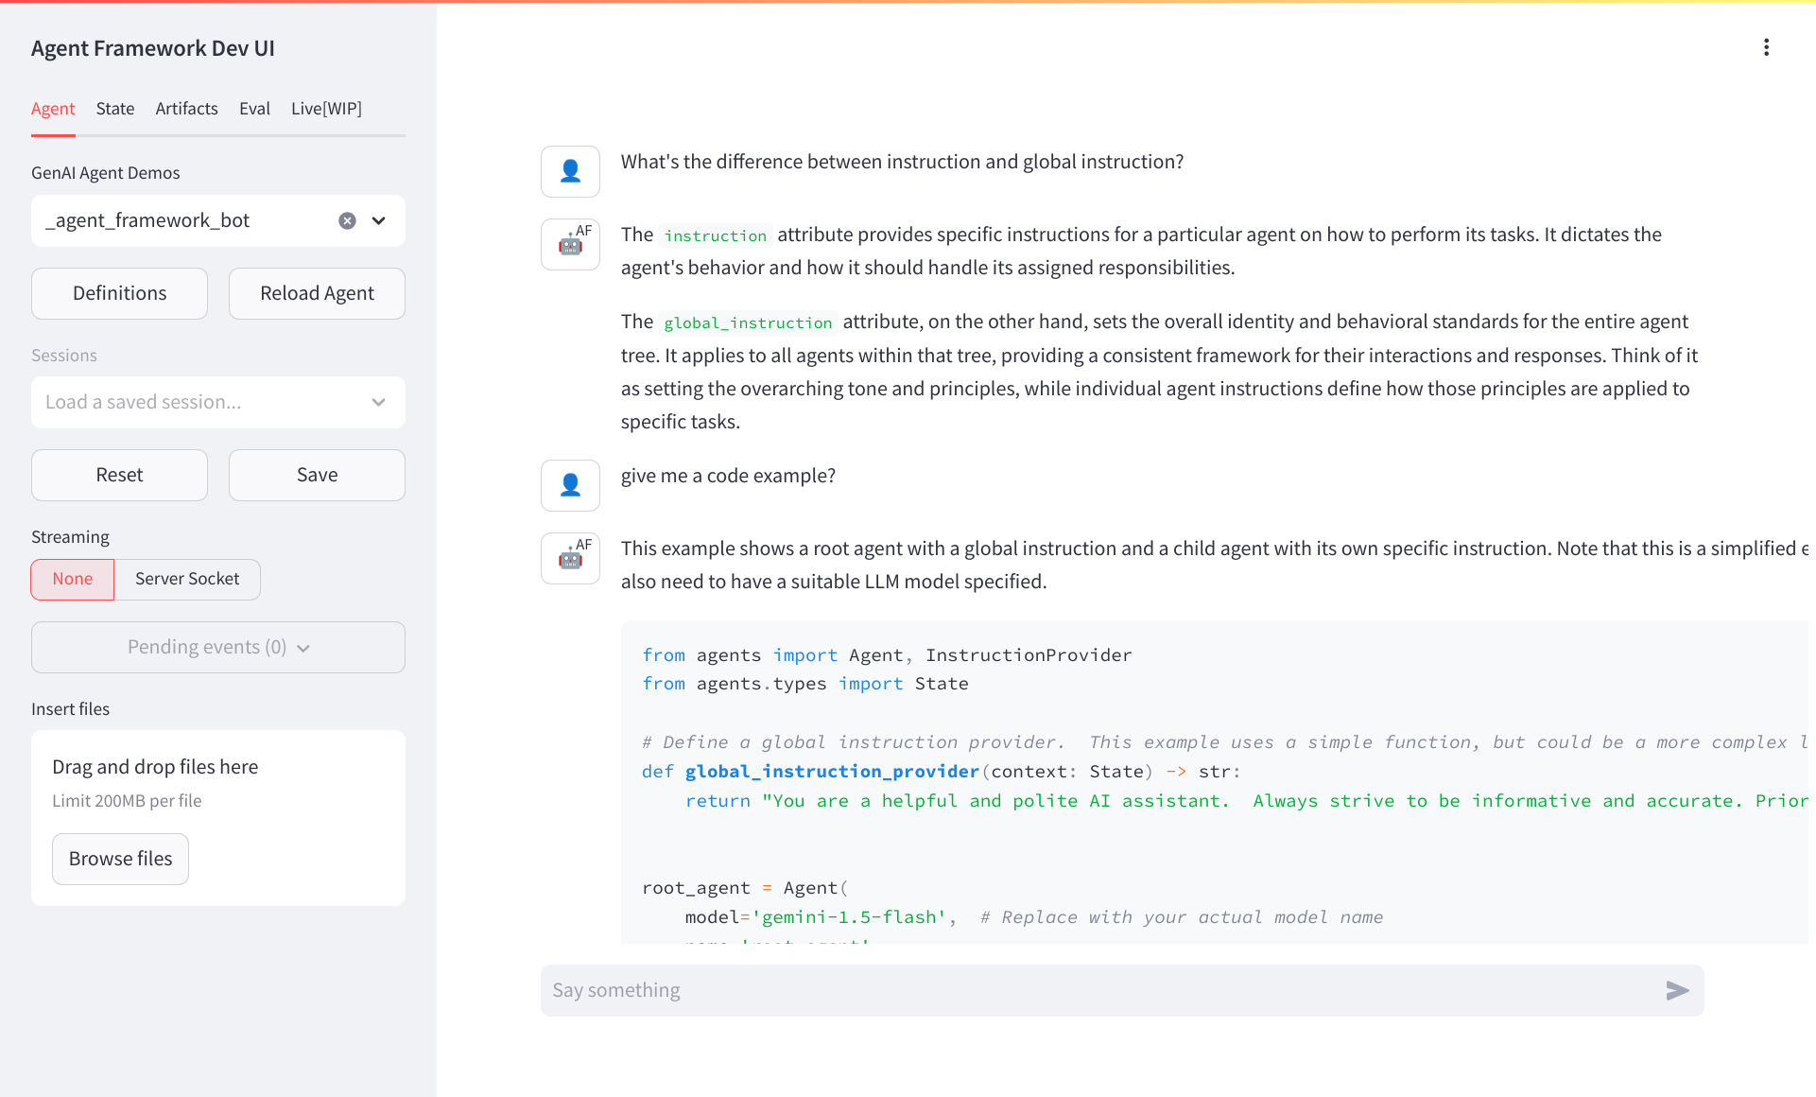
Meta-agent: The Agent of Agents
ADK has a meta-agent: An agent that knows everything about the ADK.
Just open _agent_framework_bot in your demo list, and ask it anything related to the framework. It will give you an answer, sometimes with a sample code snippet happily and patiently!

Slide 27
Hands on Training
Building a basic agent using Agent Kit

Slide 28
Hands on Training
ADK deployment to AE

Slide 29
Hands on Training
Agent Evaluation on ADK

Slide 30
Integration with Agent Space

Slide 31
Q&A and Wrap-up

Slide 32
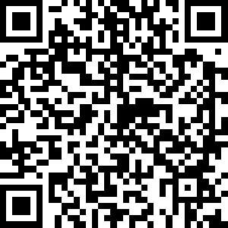
Q&A and Wrap-up
Call to Action:
Be the ADK Ambassadors.
Try it, Talk about it.
We love your Feedback 👉
Publicity:
Test & provide feedback:
ADK Sample Repo
Join the Fishfood event
https://forms.gle/ny5s9A9TVfvHDCiR9

